Slide 1

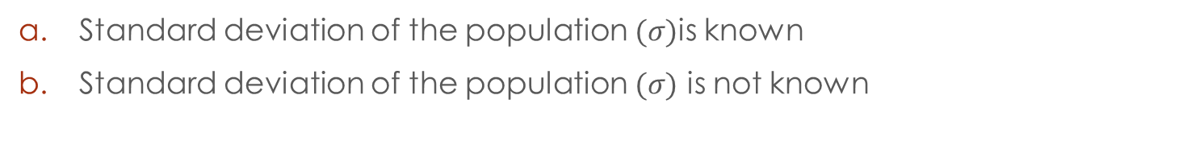
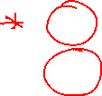
Confidence intervals Estimating a population mean
Standard deviation of the population $(σ)$is known
Standard deviation of the population $(σ)$ is not known

Slide 2
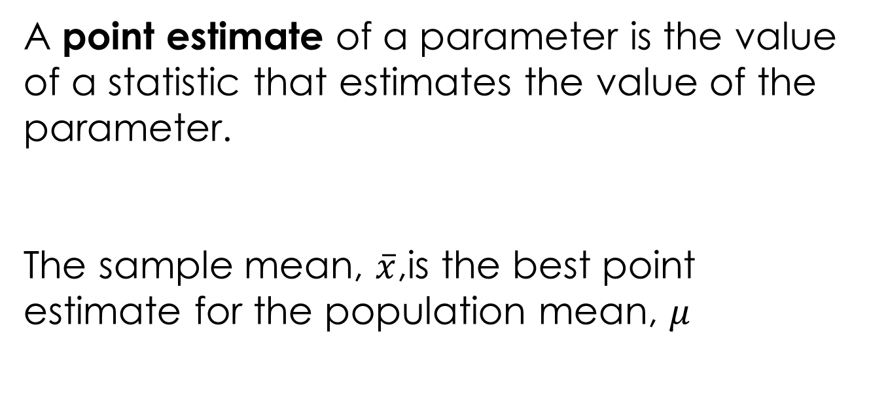
A point estimate of a parameter is the value of a statistic that estimates the value of the parameter.
The sample mean, $\overline{x}$,is the best point estimate for the population mean, $μ$

Slide 3

A confidence interval estimate of a parameter consists of an interval of numbers along with a probability ( a level of confidence) that the interval contains the unknown parameter.
E
When we try to estimate the mean GPA of the students from a certain college, we can use a sample of students randomly selected from the population of students at that college and calculate the mean of that sample. This mean (the sample mean) would be a point estimate of the population mean.
Another way of estimating the population mean would be to find an interval for which we can have a certain degree of confidence that will contain the population mean.

Slide 4
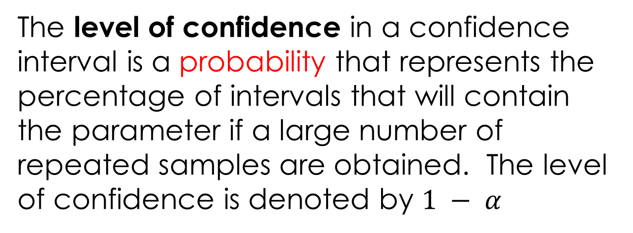

The level of confidence in a confidence interval is a probability that represents the percentage of intervals that will contain the parameter if a large number of repeated samples are obtained. The level of confidence is denoted by $1 − α$
E
For example, a 95% level of confidence would mean that if 100 confidence intervals were constructed, each based on a different sample from the same population, we would expect 95 of the intervals to contain the population mean.

Slide 5
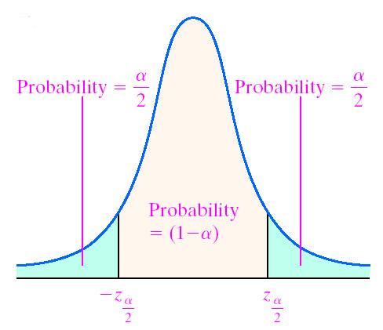






The level of confidence
${±z}_{\frac{α}{2}}$ represents the confidence coefficient or the critical value

Slide 6
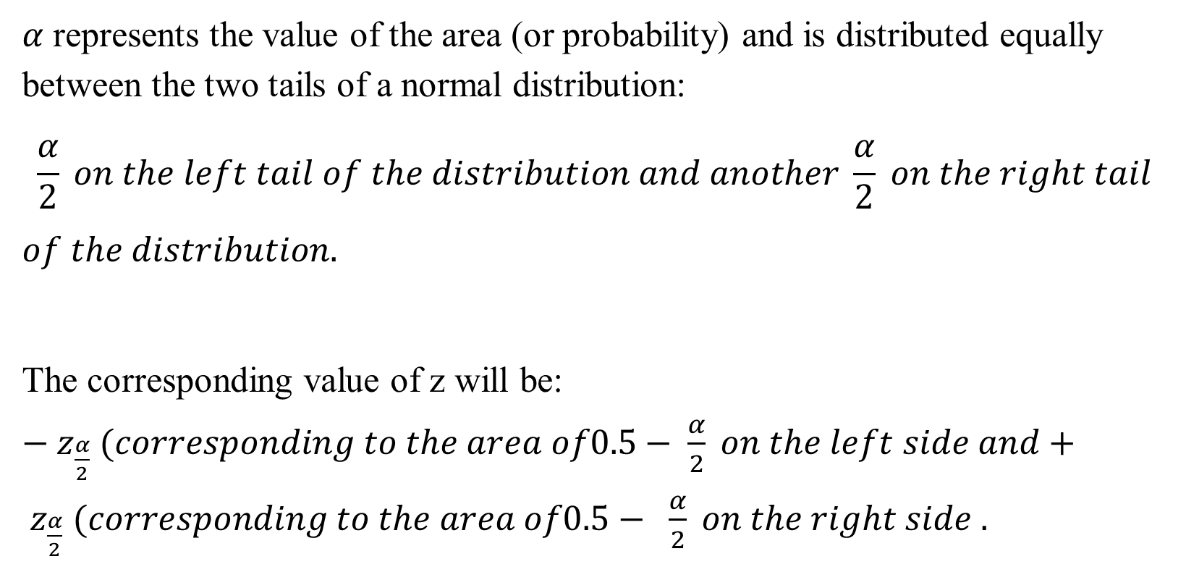
$α$ represents the value of the area (or probability) and is distributed equally between the two tails of a normal distribution:
$$\frac{α}{2} on the left tail of the distribution and another \frac{α}{2} on the right tail$$
$$of the distribution.$$
The corresponding value of z will be: $−z_{\frac{α}{2}} (corresponding to the area of0.5− \frac{α}{2} on the left side and+ z_{\frac{α}{2}} (corresponding to the area of0.5− \frac{α}{2} on the right side .$

Slide 7
The most used values for the degrees of confidence are: 90%, 95% and 99%.

Slide 8

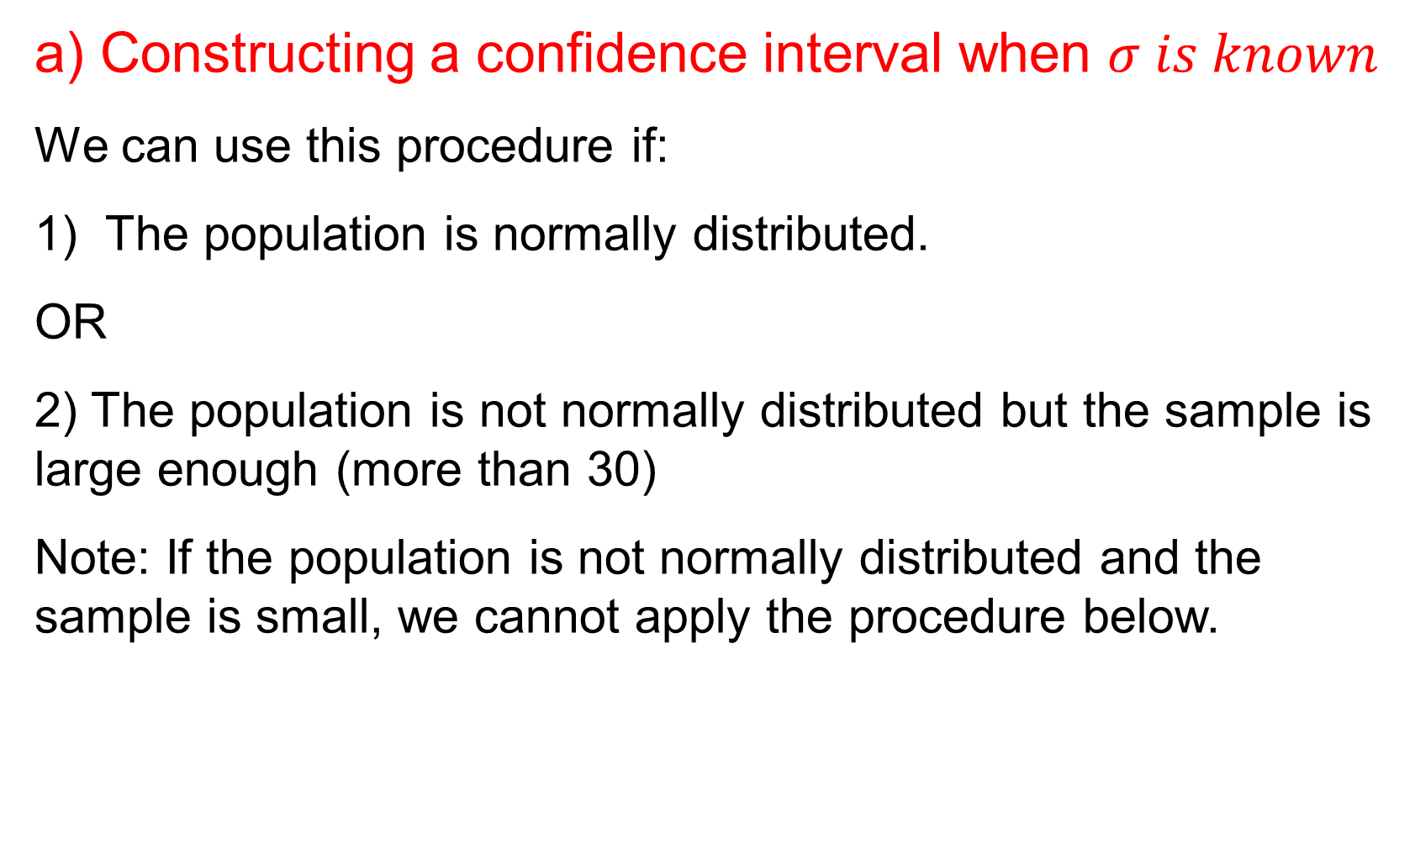



a) Constructing a confidence interval when $σ is known$
We can use this procedure if:
The population is normally distributed.
OR
2) The population is not normally distributed but the sample is large enough (more than 30)
Note: If the population is not normally distributed and the sample is small, we cannot apply the procedure below.

Slide 9










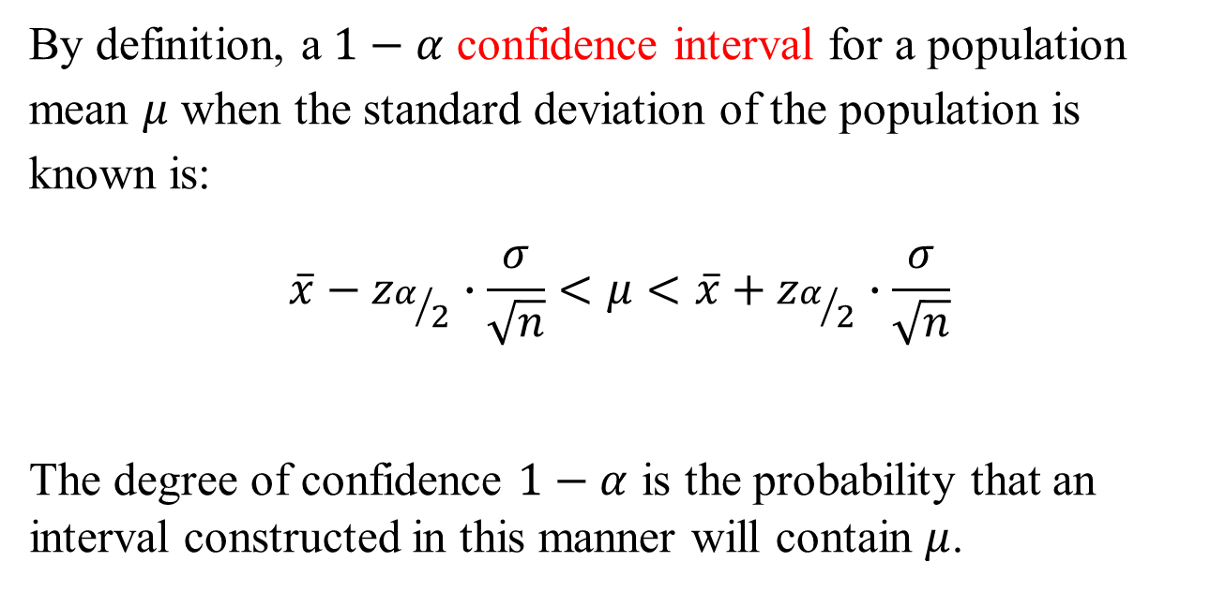
By definition, a $1−α$ confidence interval for a population mean $μ$ when the standard deviation of the population is known is:
$$\overline{x}−z_{α/2}∙\frac{σ}{\sqrt{n}}<μ<\overline{x}+z_{α/2}∙\frac{σ}{\sqrt{n}}$$
The degree of confidence $1−α$ is the probability that an interval constructed in this manner will contain $μ$.

Slide 10
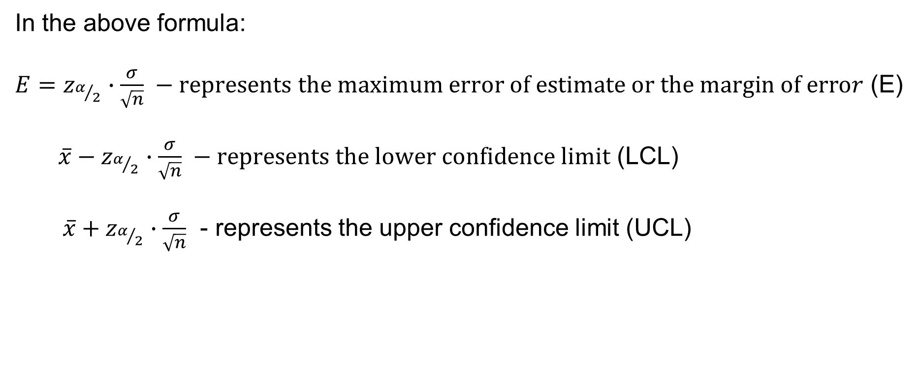

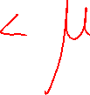



In the above formula:
${E=z}_{α/2}∙\frac{σ}{\sqrt{n}} −represents the maximum error of estimate or the margin of error$ (E)
$\overline{x}−z_{α/2}∙\frac{σ}{\sqrt{n}} −represents the lower confidence limit$ (LCL)
$\overline{x}+z_{α/2}∙\frac{σ}{\sqrt{n}}$ - represents the upper confidence limit (UCL)

Slide 11
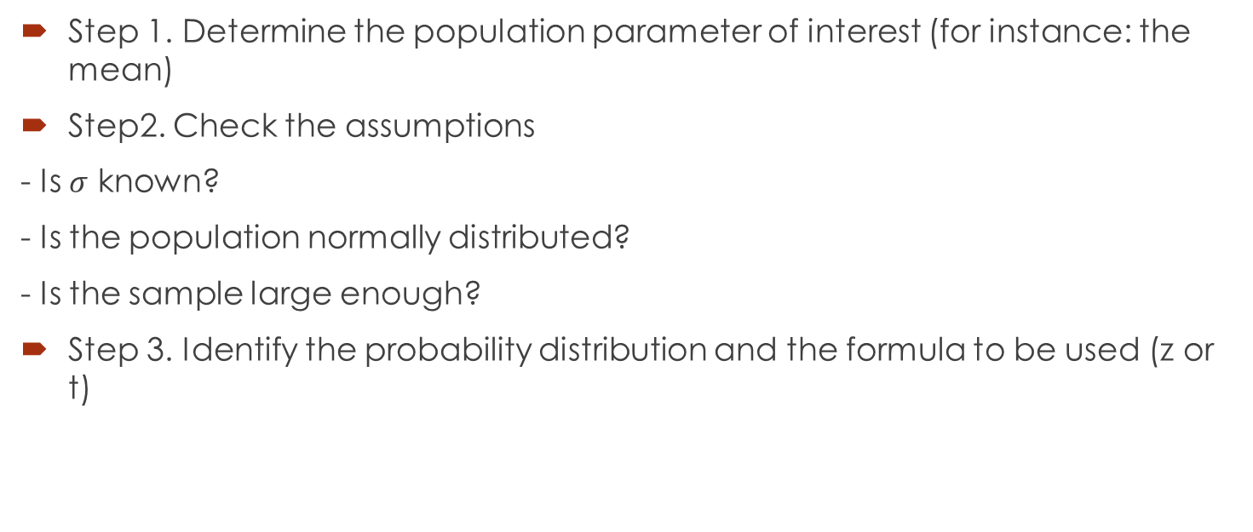
Steps for finding a confidence interval

Slide 12
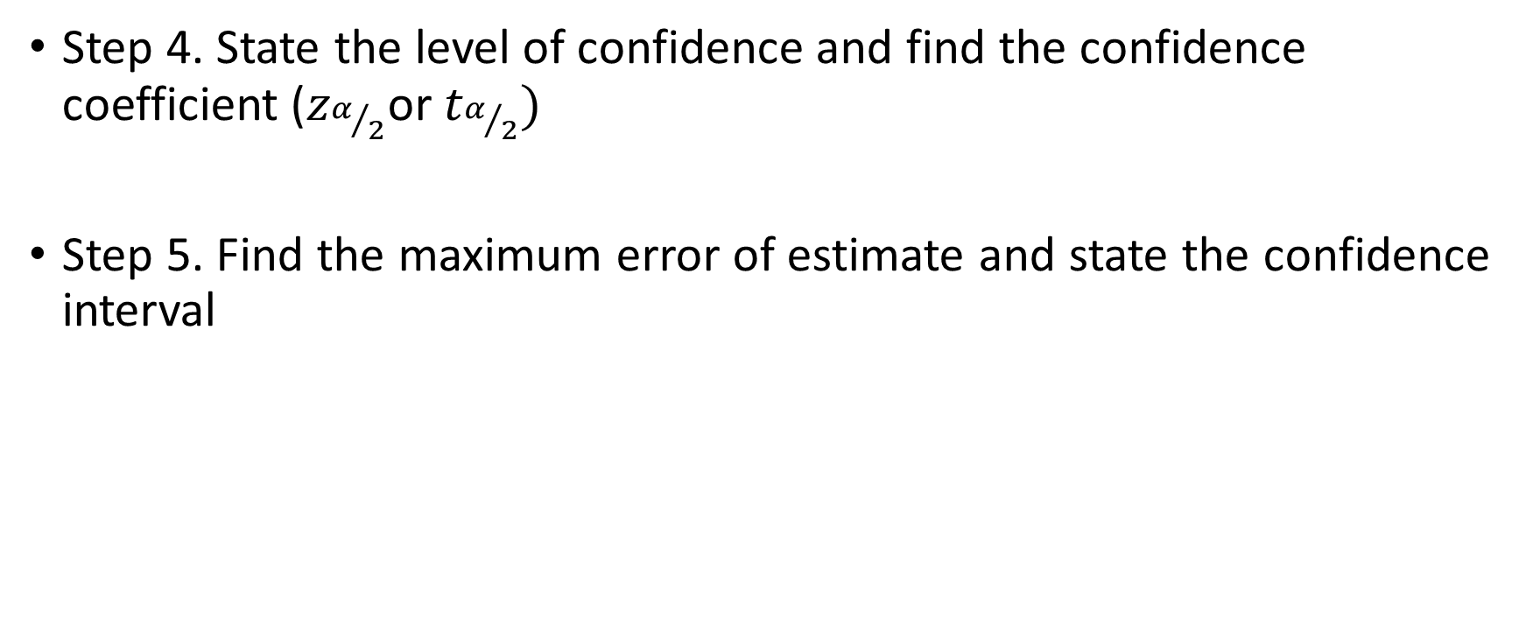

Steps continued
Step 4. State the level of confidence and find the confidence coefficient ($z_{α/2}$or $t_{α/2})$
Step 5. Find the maximum error of estimate and state the confidence interval

Slide 13




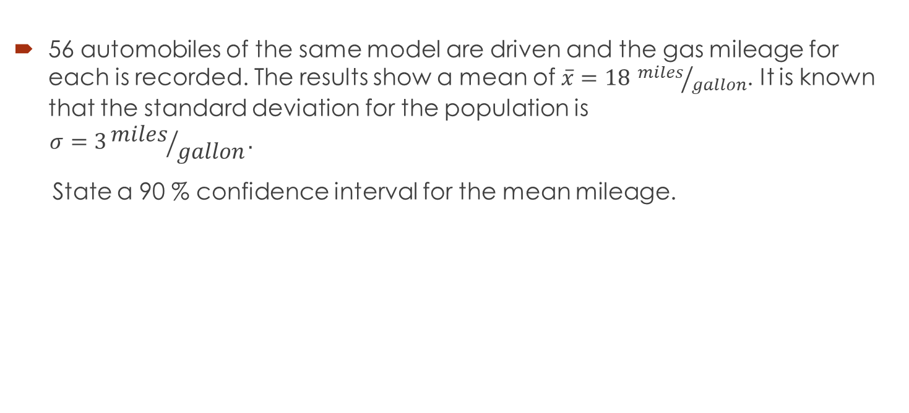


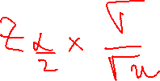






Example
E
56 automobiles of the same model are driven and the gas mileage for each is recorded. The results show a mean of $\overline{x}=18$ ${miles}/{gallon}$. It is known that the standard deviation for the population is
$$σ=3{miles}/{gallon}.$$
State a 90 % confidence interval for the mean mileage.

Slide 14






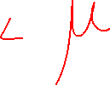








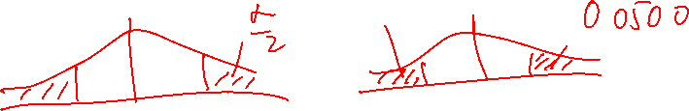






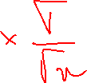







Slide 16

Constructing a confidence interval when sigma is not known (when we know s – the standard deviation of the sample
We can use this procedure if:
1) The population is normally distributed.
OR
2) The population is not normally distributed but the sample is large enough (more than 30)
Note: If the population is not normally distributed and the sample is small, we cannot apply the procedure below.

Slide 17

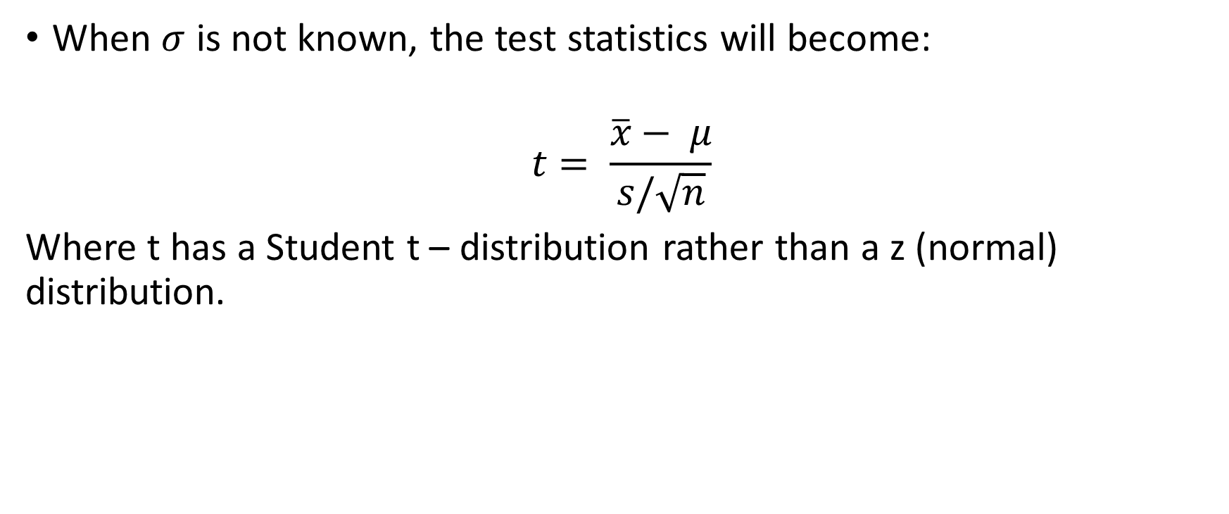



The new test statistic…
When $σ$ is not known, the test statistics will become:
$$t= \frac{\overline{x}− μ}{s/\sqrt{n}}$$
Where t has a Student t – distribution rather than a z (normal) distribution.

Slide 18



Properties of Student t - distribution
E
1) There are an infinite number of distributions, each of them having a number associated with it called the degrees of freedom. The number of degrees of freedom for a data set corresponds to the number of sample values that can vary after certain restrictions have been imposed on all data values.
Meaning: For instance, if we say that 10 students have scores with a mean of 80, then we can freely assign values to the first 9 scores, but the 10th score will be determined.
The number of degrees of freedom is df = n – 1

Slide 19
Properties continued
2) It follows that Student t-distribution is different for different sample sizes.
3) A t - distribution is similar to a normal distribution, being symmetrical to the vertical line through 0; the curve extends indefinitely to the right and to the left. The total area under the curve is 1.

Slide 20
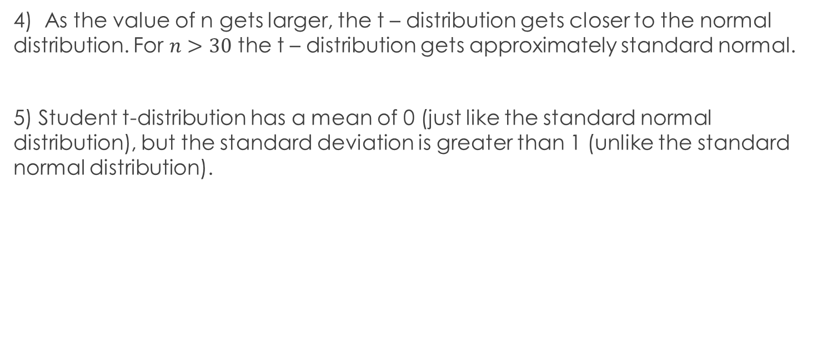
Properties continued
4) As the value of n gets larger, the t – distribution gets closer to the normal distribution. For $n>30$ the t – distribution gets approximately standard normal.
5) Student t-distribution has a mean of 0 (just like the standard normal distribution), but the standard deviation is greater than 1 (unlike the standard normal distribution).

Slide 21
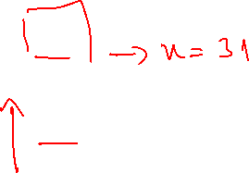

t distribution
Z standard normal distribution

Slide 22
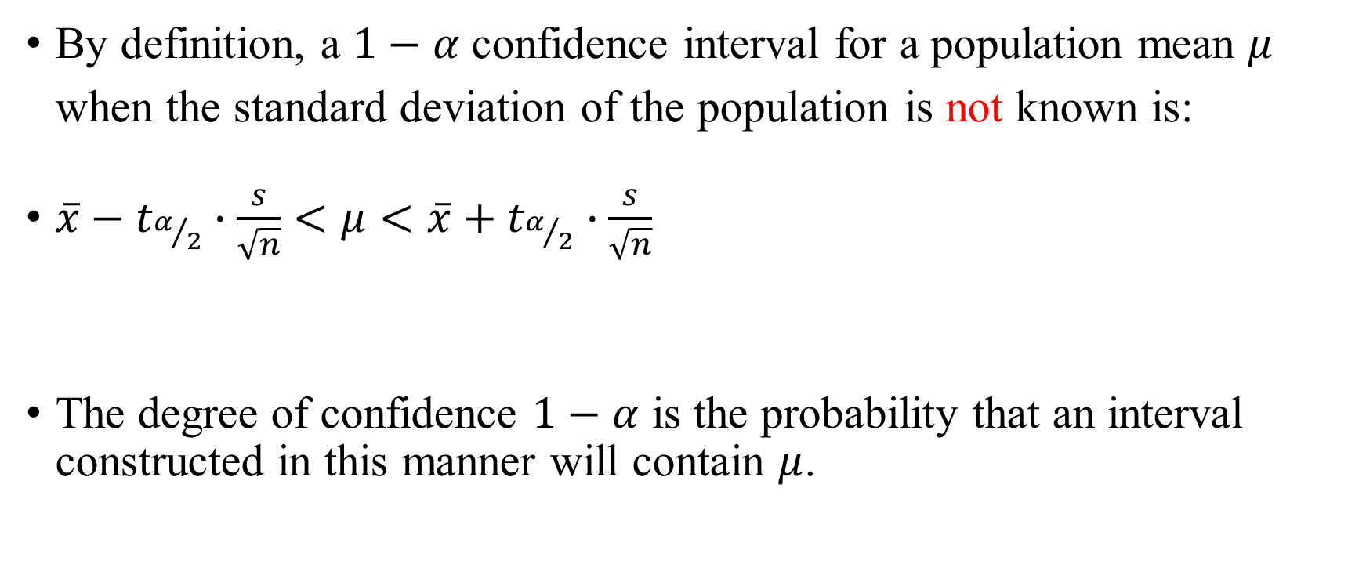

The confidence interval formula
By definition, a $1−α$ confidence interval for a population mean $μ$ when the standard deviation of the population is not known is:
$\overline{x}−t_{α/2}∙\frac{s}{\sqrt{n}}<μ<\overline{x}+t_{α/2}∙\frac{s}{\sqrt{n}}$
The degree of confidence $1−α$ is the probability that an interval constructed in this manner will contain $μ$.

Slide 23


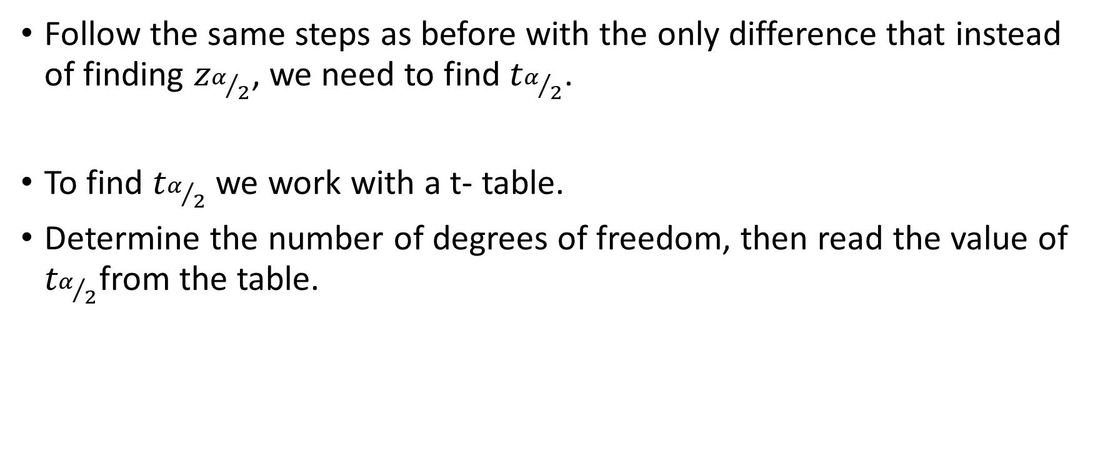
Steps for finding a confidence interval when $σ$ is not known
Follow the same steps as before with the only difference that instead of finding $z_{α/2}$, we need to find $t_{α/2}$.
To find $t_{α/2}$ we work with a t- table.
Determine the number of degrees of freedom, then read the value of $t_{α/2}$from the table.

Slide 24
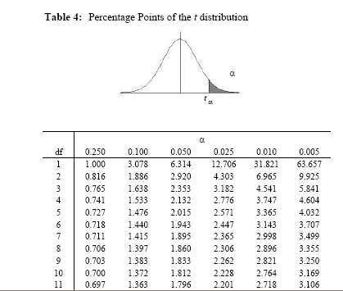







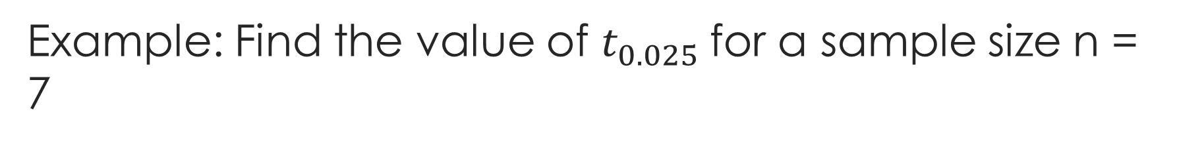
Example: Find the value of $t_{0.025}$for a sample size n = 7
Look up α
Look up df

Slide 25





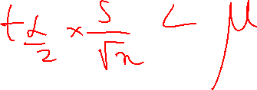



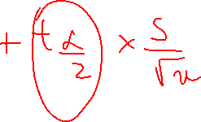


Example
E
In a study of athletes, a psychologist administered a questionnaire, designed to measure the anxiety level to 20 athletes. The 20 scores for athletes gave $\overline{x}=65.2 and s=7.5$. Find the 95% confidence interval for the mean score $μ$ for the population of athletes from which the sample was obtained. If $μ$ is estimated by $\overline{x}$, find the maximum error of estimate with 95% level of confidence. Assume the population is approximately normal.

Slide 26
























Slide 27
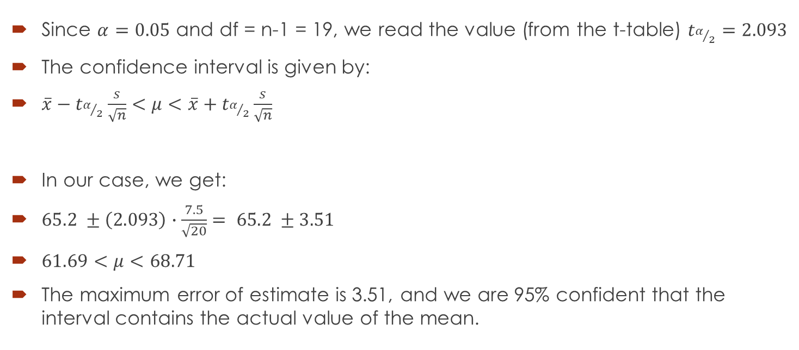
Solution
Since $α=0.05$ and df = n-1 = 19, we read the value (from the t-table) $t_{α/2}=2.093$
The confidence interval is given by:
$\overline{x}−t_{α/2}\frac{s}{\sqrt{n}}<μ<\overline{x}+t_{α/2}\frac{s}{\sqrt{n}}$
In our case, we get:
$65.2 ±\left(2.093\right)∙\frac{7.5}{\sqrt{20}}= 65.2 ±3.51$
$61.69<μ<68.71$
The maximum error of estimate is 3.51, and we are 95% confident that the interval contains the actual value of the mean.

Slide 28


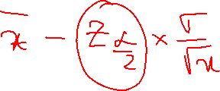








Question 1
A study of 30 English professors found that they spent on average 12. 6 minutes correcting a paper. If the standard deviation for the population of times spent on correcting a paper is 2.5 minutes, find the 90% confidence interval for the mean of all papers. Consider a normally distributed population.

Slide 29































Slide 30




















Question 2
Average score obtained by 25 students in a test is 75. It is known that the standard deviation of the population of scores is 8. Find the confidence interval at 95% confidence level, assuming the scores are normally distributed.

Slide 31

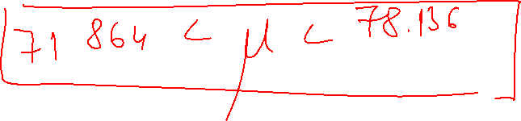











Slide 32
















Question 2 – modified
Average score obtained by 25 students in a test is 75. The standard deviation for the sample of scores is 8. Find the confidence interval at 95% confidence level, assuming the scores are normally distributed.

Slide 33











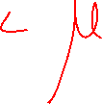


Slide 34













Question 3
21 employees from a certain company travel to work an average of 14.3 miles. The standard deviation of their travel time was 2 miles. Find the 95% confidence interval of the true mean of the population, considering the data is normally distributed.

Slide 35





















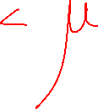



Slide 36








Question 4
The average yearly income for 17 engineering graduates in 2008 was $56,718. The standard deviation for the population of incomes is known to be $650. Find the 90% confidence interval for the population mean, considering the population is normally distributed.

